Slide 1
MarketStreet Advisory Committee Updates
May 10, 2018

Slide 2
Agenda
Industry info
Zoning – “Spot Zoning” question
Massing and Design
Public Safety

Slide 3
Industry Info – additional articles on “how the theater industry has reinvented itself”

Slide 4
2. Zoning - Response to Question on “Spot Zoning”
“Spot zoning only occurs when there is a ‘singling out of one lot for different treatment from that accorded to similar surrounding land indistinguishable from it in character, [and] all for the economic benefit of the owner of the lot.’”
“If there is any public benefit, a rezoning cannot be spot zoning even if a private landowner will derive some benefit.”

Slide 5
Design – Further Detail on Conceptual
Massing

Slide 8
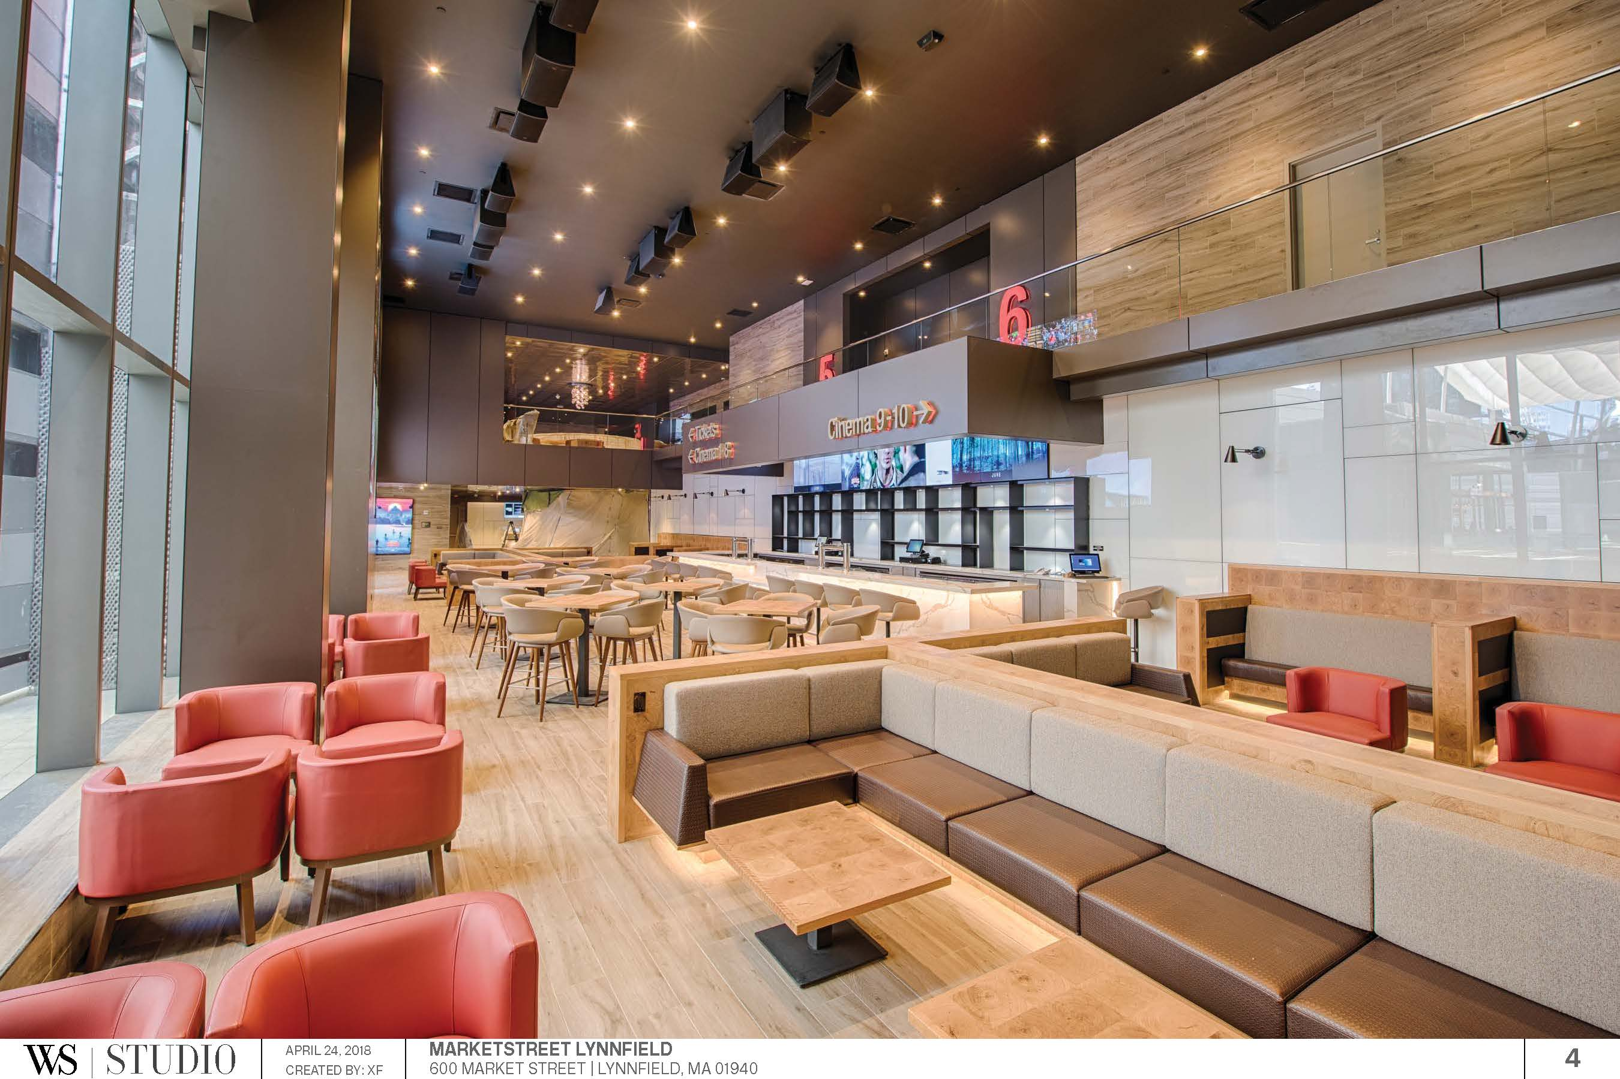

Slide 9
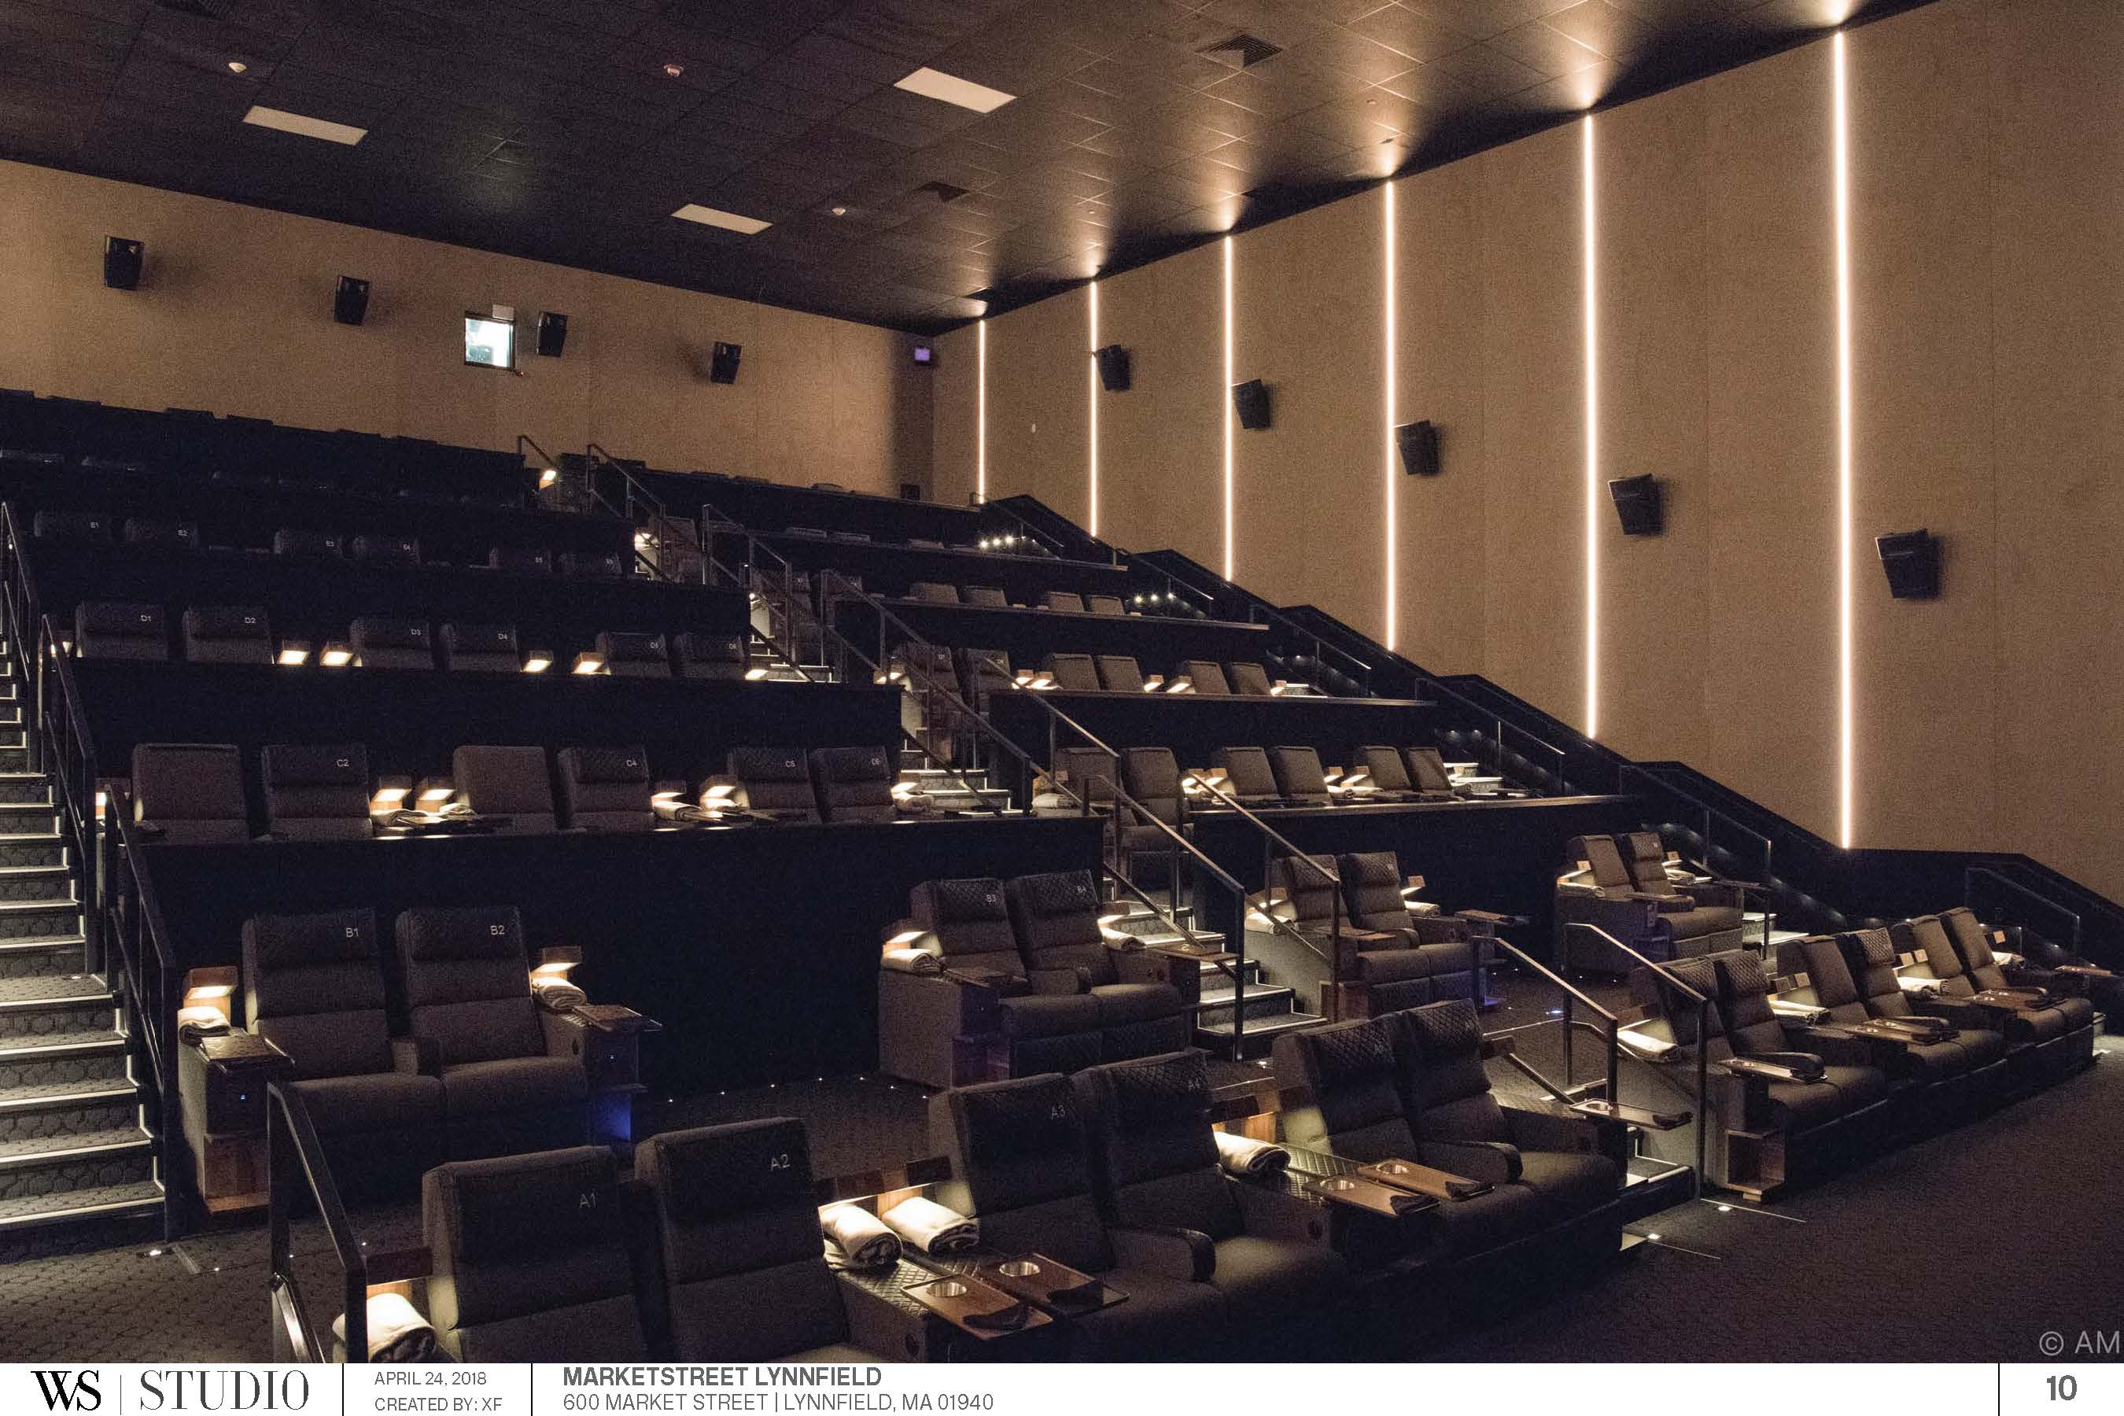

Slide 10
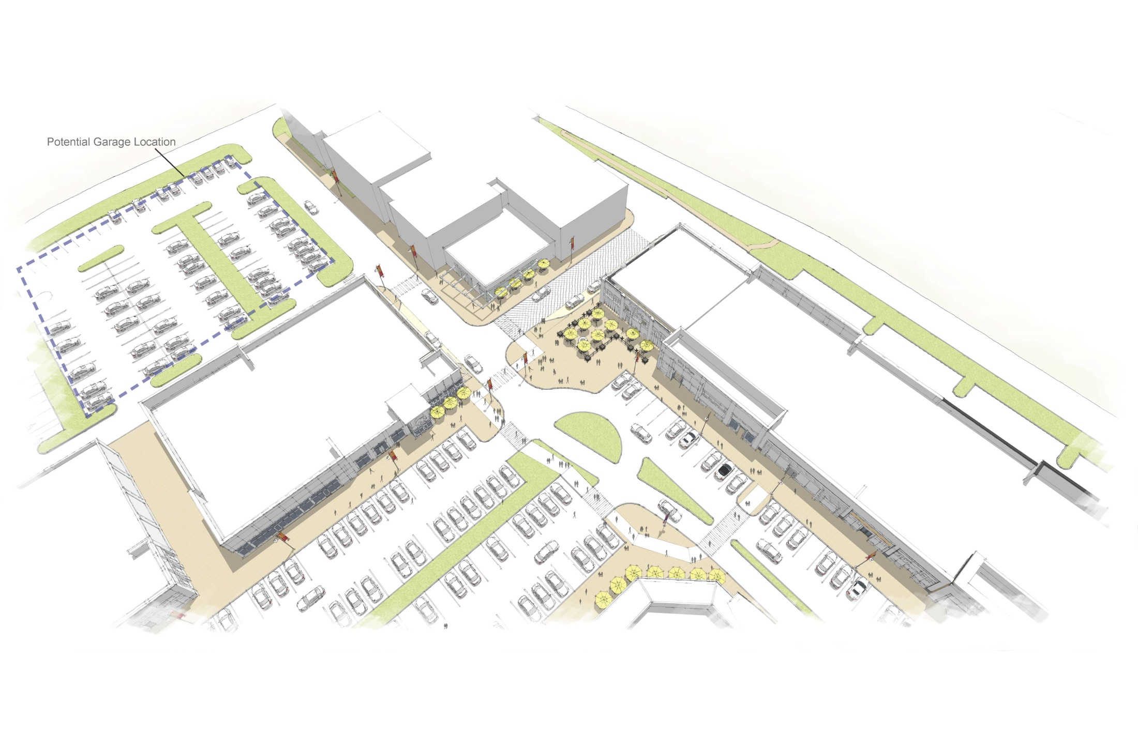

Slide 11
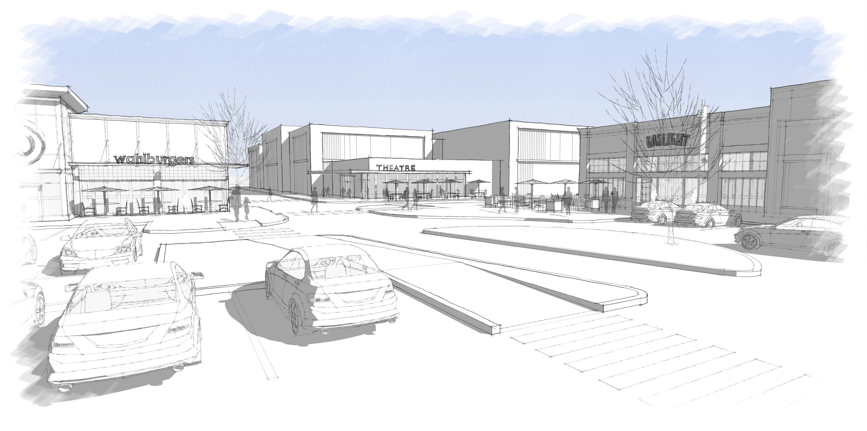

Slide 12
Design Standards – Scale and Proportions
Front setback line is encouraged to keep a consistent “street wall.”
Building facades more than 50 feet wide shall be broken down into a series of smaller elements.
Two story building design shall maintain the distinction between upper and lower floors.

Slide 13
Design Standards – Building Facades
Projecting bays, columns, recessed balconies, and roof shape variation should be utilized.
Side and rear facades may be less detailed than the primary façade but shall be generally consistent with the primary façade’s architectural style.

Slide 14
Design Standards – Roof Profiles
Shall employ varied vertical and horizontal planes for visual relief to the tops of buildings. Design elements such as parapets, cornices, towers and piers may also be used to break up the horizontal massing.
HVAC equipment shall be screened.
Buildings shall, when considered in relation to adjacent structures, incorporate a diversity of roof heights, gable orientations, and volumes.

Slide 15
Design Standards – Materials and Color
Building façade materials including but not limited to brick, wood, cementitious fiber board, manufactured limestone, cast stone, masonry, stone, glass, terra cotta, cellular PVC, trim, tile and sustainable materials are permitted.
The use of exterior insulation finishing system (EIFS)… is prohibited below eight (8) feet above finish floor.
A combination of materials should be used within a building.

Slide 16
4. Public Safety
Response to Chief Breen’s questions on
alcohol policy.

Slide 17
MarketStreet Advisory Committee Updates
May 10, 2018

