Slide 1
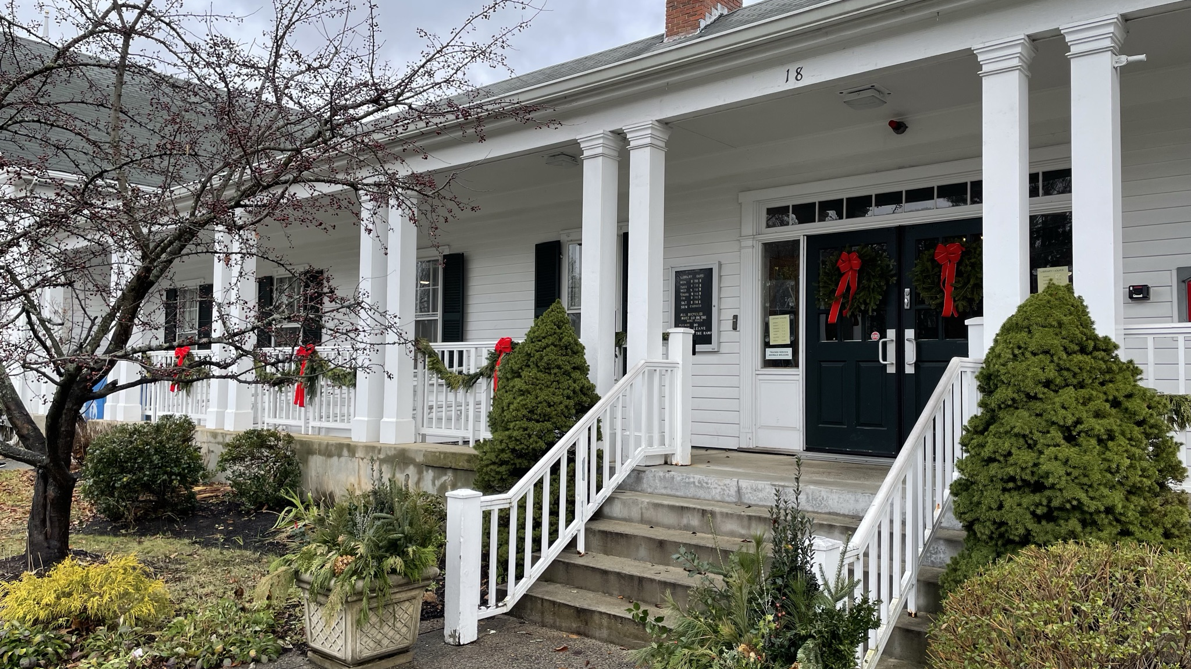

Options for the Existing Library
Lynnfield Library
FEASIBILITY STUDY
Priorities
3 Options
Next Steps
02/27/24

Slide 2
Priorities
Lynnfield Library
FEASIBILITY STUDY
Library Programs/Group Meetings
Create alternates for additions to building that would expand programming and meeting capabilities
Repairs
Maintenance/Safety and Building Code issues
Roof, Water in Basement, ADA compliant Bathrooms and Ramps, Electrical issues etc...
Mezzanine
Noise abatement between second floor balcony meeting area and main reading room
Staff Space
Improve staff work areas and service desks for efficiency and service
Site Accessibility
Improve cross walks and handicap access to the building.
Children’s
Improve program space within children’s reading area
Off-Site
Consider whether any program can be located off-site to make space for other functions
Building Character
Preservation of the facade to the extent it reflects the historic nature of the common.
Collections
Storing DVD’s and movies in other areas to open that shelf space.
Spatial Quality
Keep/preserve the open space on the main floor.

Slide 3
Options
Lynnfield Library
FEASIBILITY STUDY
Option 1 Repairs & Code Compliance
Option 2 Build on Option 1, Incorporating Several Library Service Enhancements
Expand in Rear Courtyard
Reclaim Attic Space in Back
Option 3 Build on 1 & 2, Incorporating More Library Service Enhancements
Reclaim Additional Attic Space in Front

Slide 4
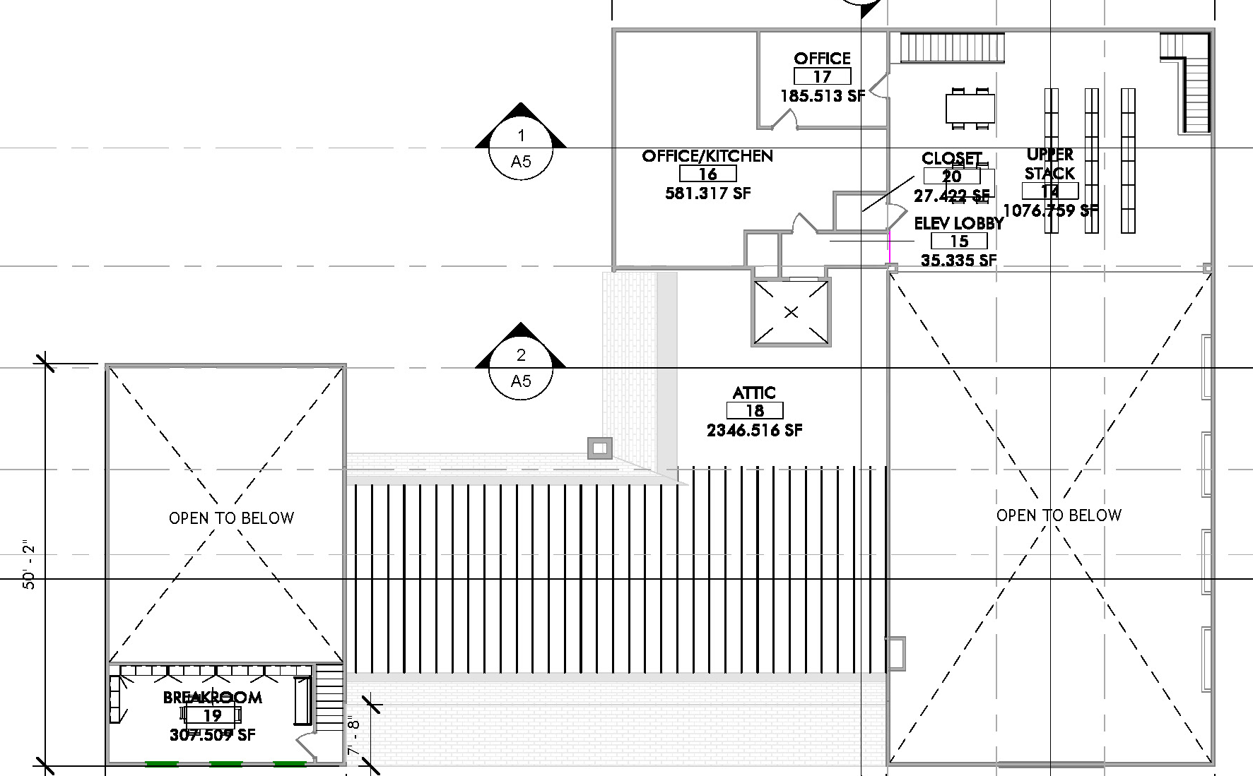
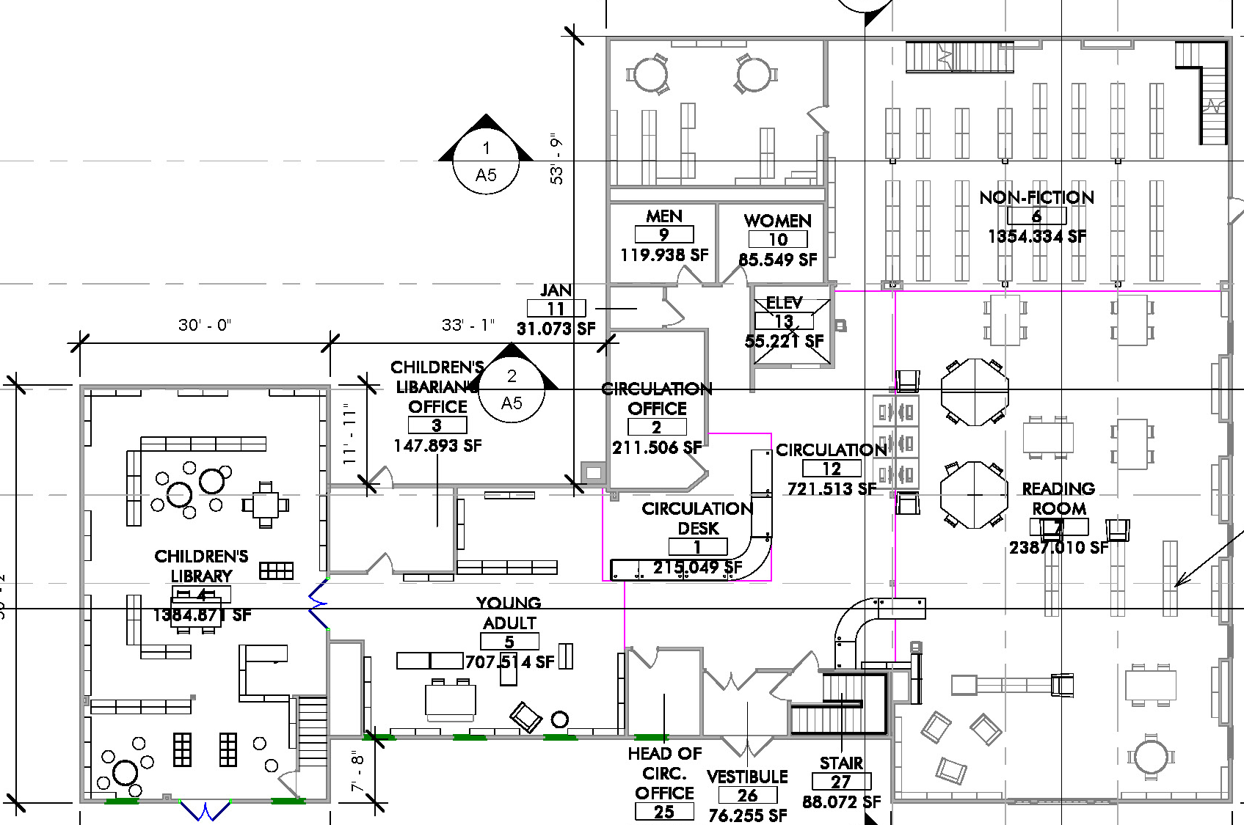
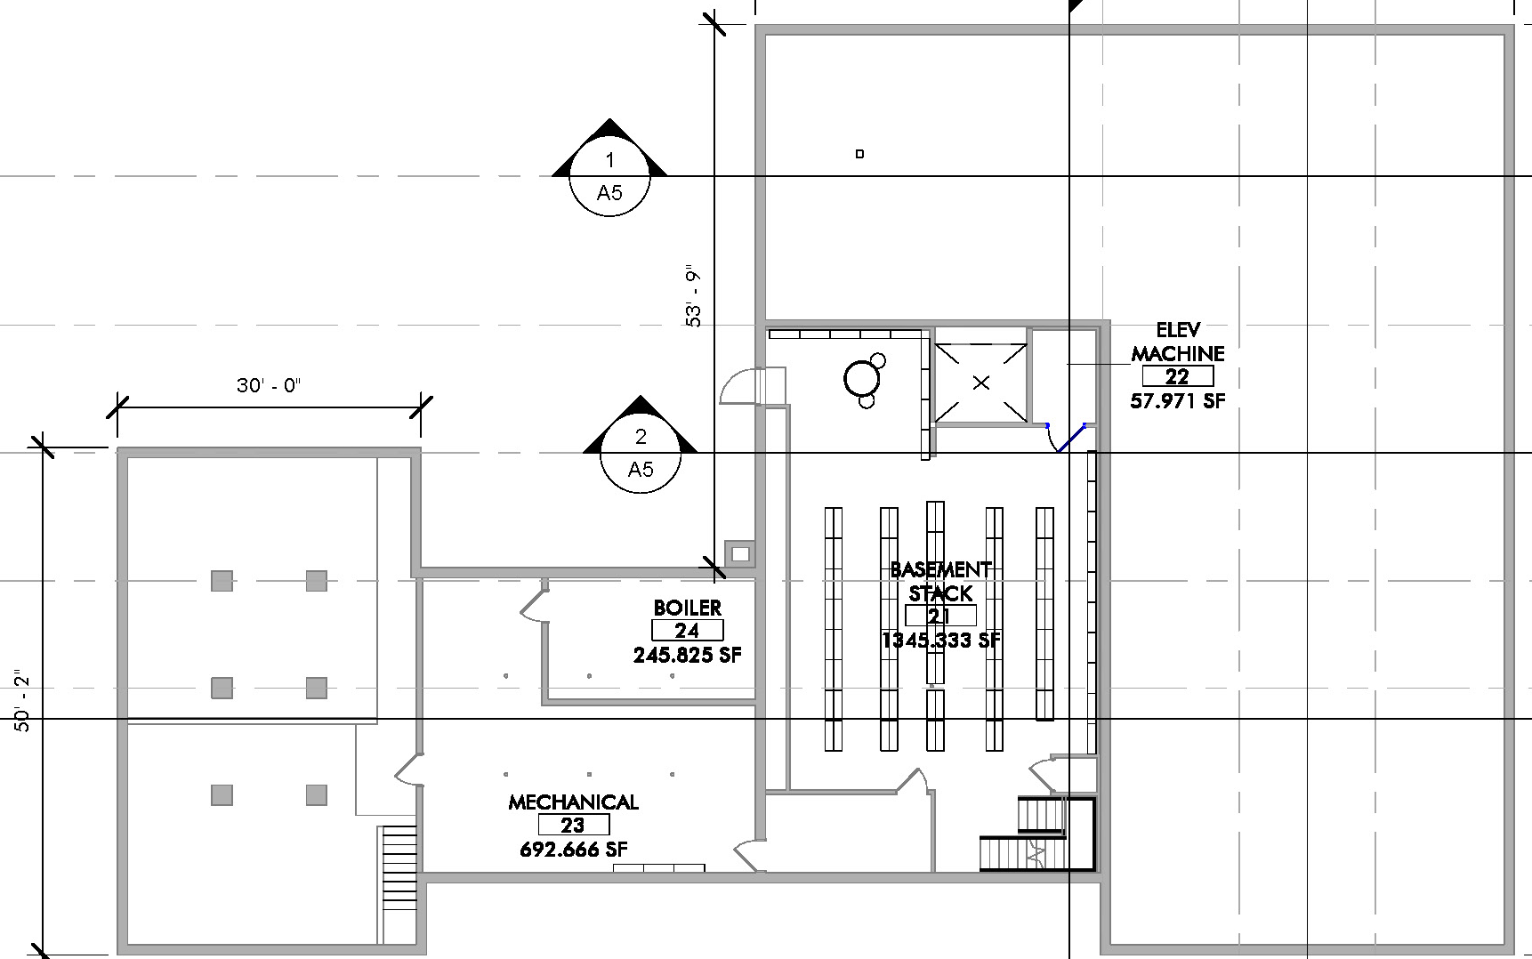
Option 1 – CODE COMPLIANCE
Lynnfield Library
FEASIBILITY STUDY
GOALS
Upgrade/Repair Building Systems
Address Accessibility (Entrance, Toilets, Breakroom)
Possibly Expand Mezzanine Collection
Possibly Locate Friends Off-Site
Second Floor Main Floor Basement

Slide 5
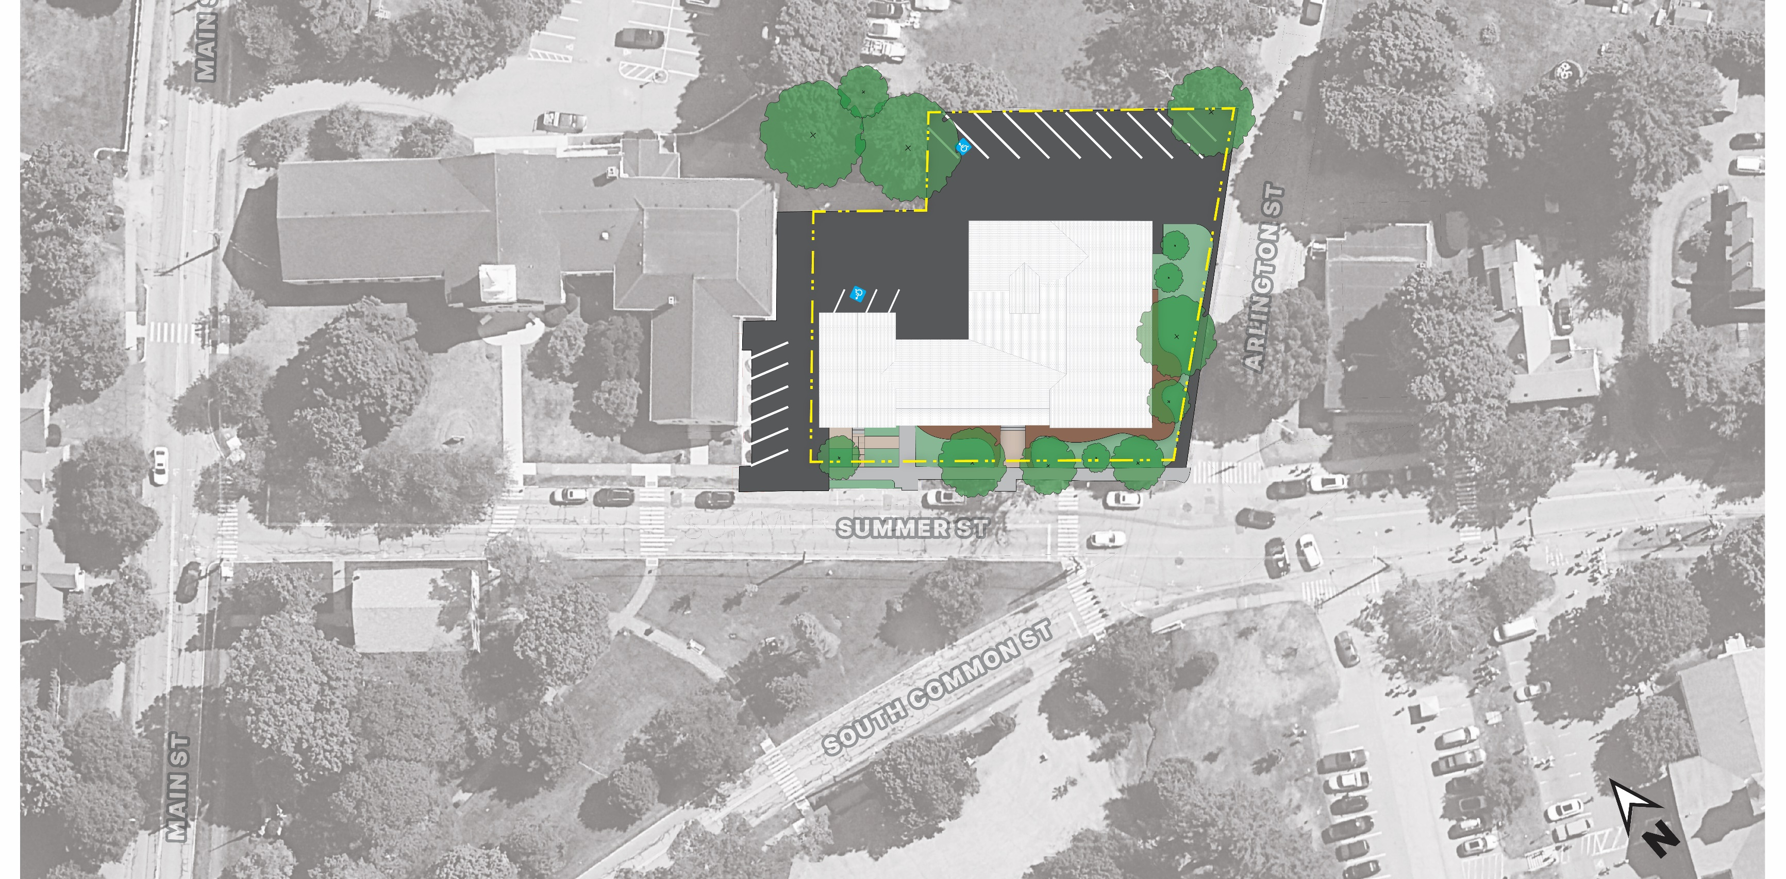
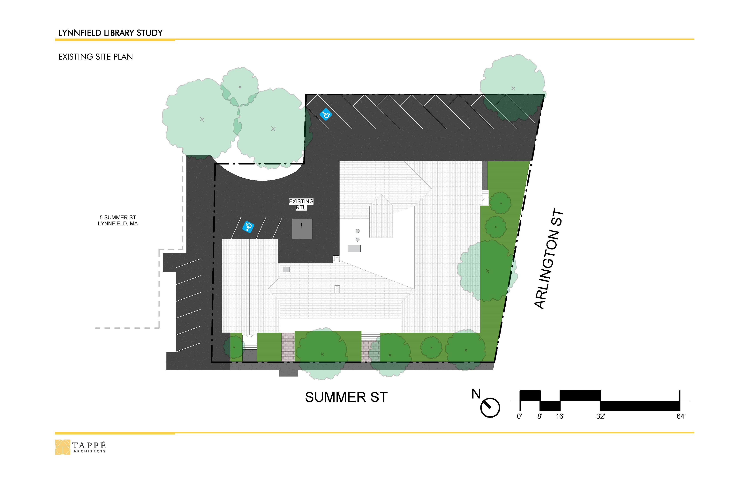
Option 1 – CODE COMPLIANCE
Lynnfield Library
FEASIBILITY STUDY

Slide 6
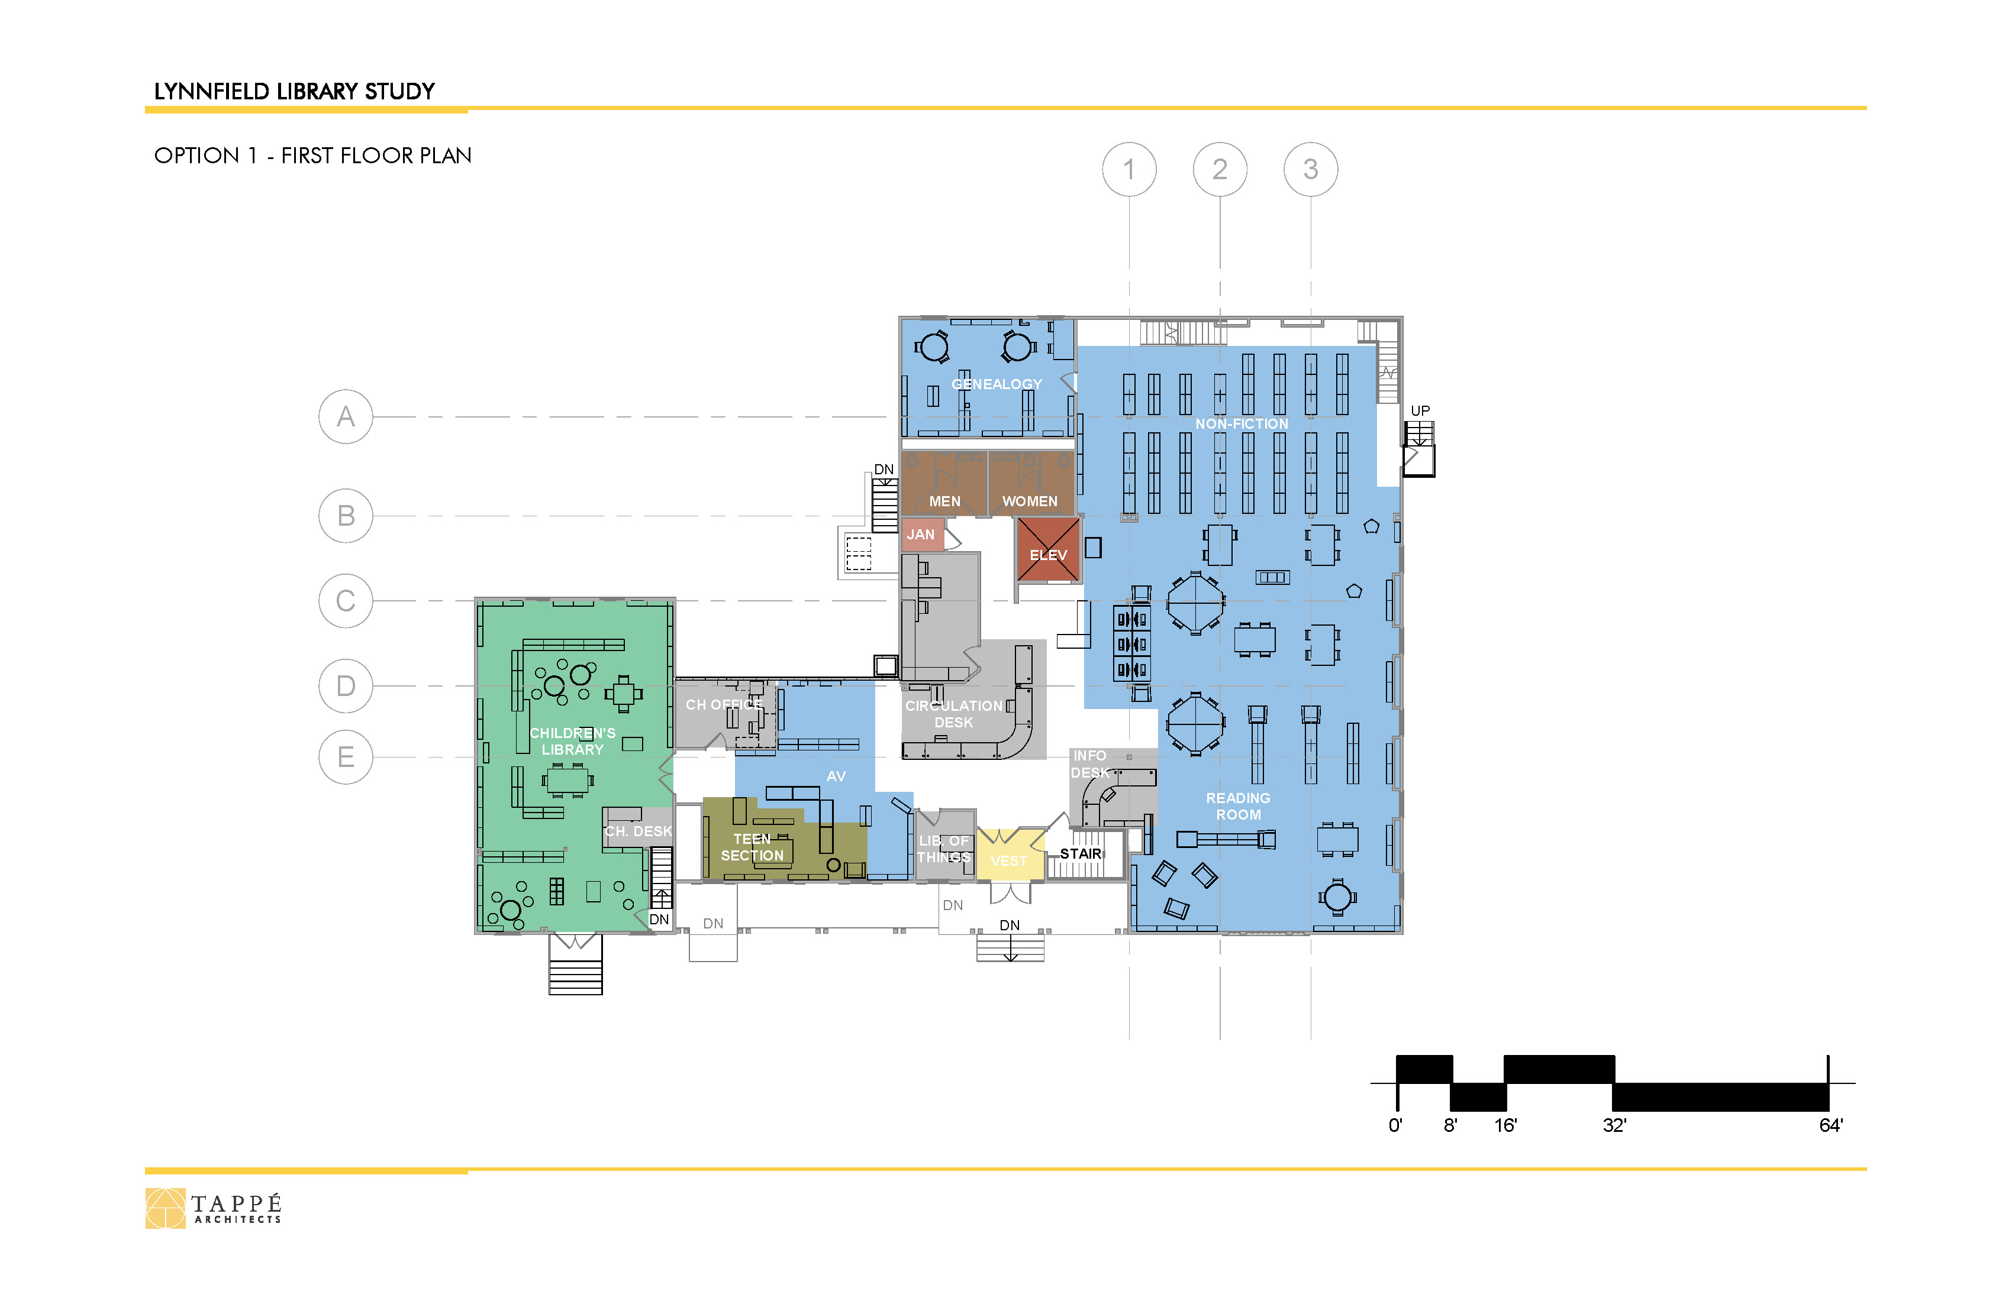
Option 1 – CODE COMPLIANCE
Lynnfield Library
FEASIBILITY STUDY

Slide 7
Option 1 – CODE COMPLIANCE
Lynnfield Library
FEASIBILITY STUDY

Slide 8
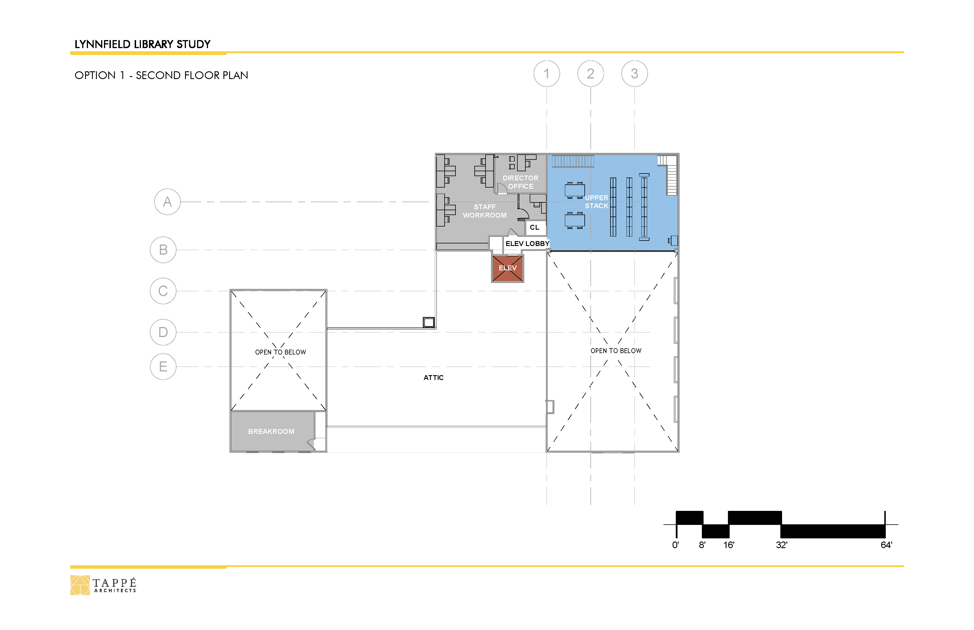
Option 1 – CODE COMPLIANCE
Lynnfield Library
FEASIBILITY STUDY
STORAGE

Slide 9
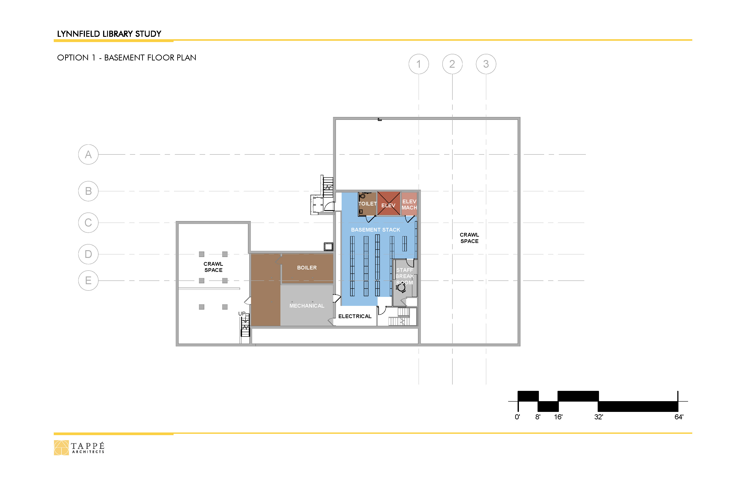
Option 1 – CODE COMPLIANCE
Lynnfield Library
FEASIBILITY STUDY
STORAGE
FRIENDS

Slide 10
Option 1 – CODE COMPLIANCE
Lynnfield Library
FEASIBILITY STUDY
Programmatic Impacts
Added Storage
Seating Maintained
Reduced Collection Capacity (approx. 5%)
Staff Breakroom Very Small, Basement Location
Friends Off-Site

Slide 11
Option 2 – COURTYARD ADDITION
Lynnfield Library
FEASIBILITY STUDY
Add Service Core in Courtyard
Add a Community Meeting Room
Add a Group Study
Add a Teen Room
Consolidate Staff
Expand Genealogy
Provide Adequate offices
Goals
Option 1 Improvements, Plus:
Second Floor Main Floor Basement

Slide 12
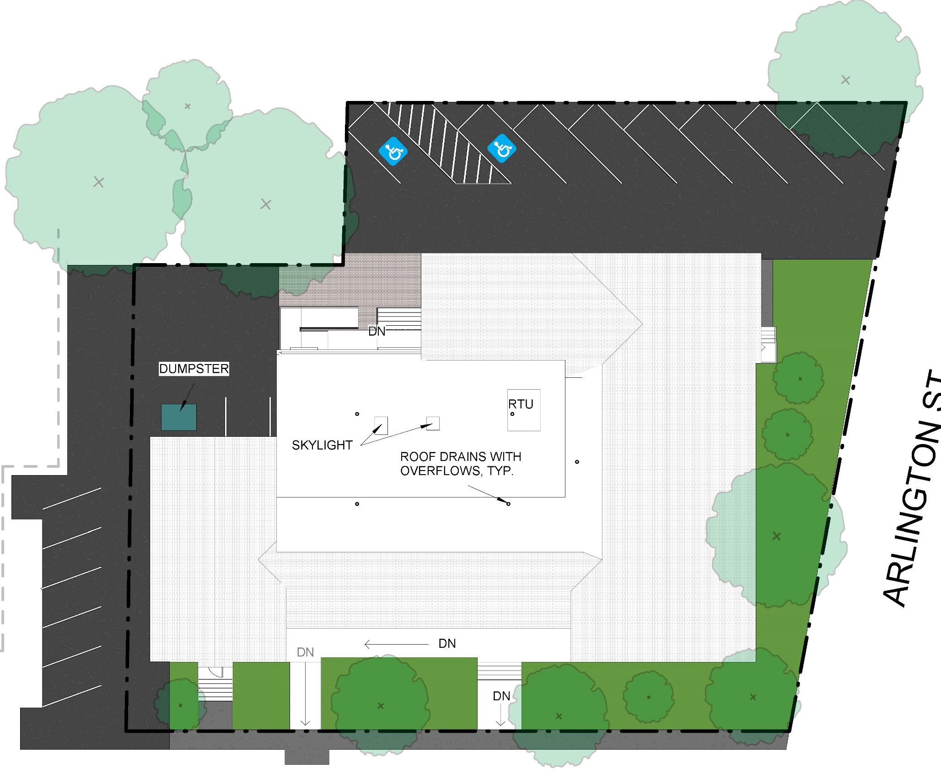
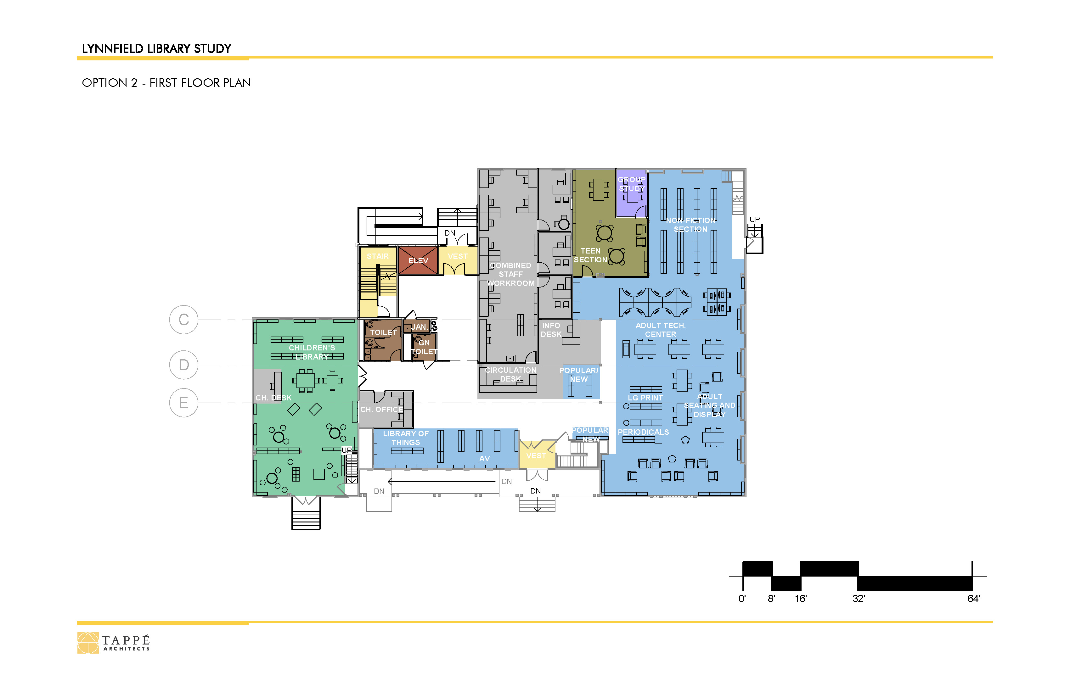
Option 2 – COURTYARD ADDITION
Lynnfield Library
FEASIBILITY STUDY

Slide 13
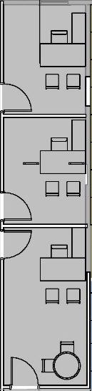
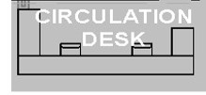
Option 2 – COURTYARD ADDITION
Lynnfield Library
FEASIBILITY STUDY

Slide 14
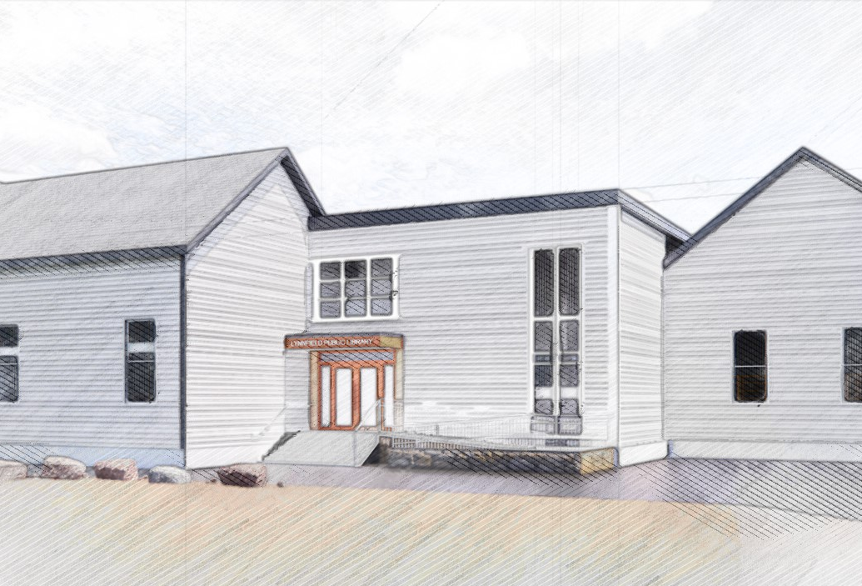
Option 2 – COURTYARD ADDITION
Lynnfield Library
FEASIBILITY STUDY

Slide 15
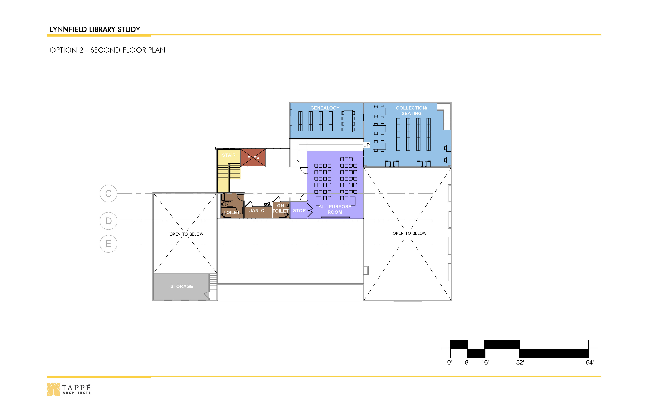
Option 2 – COURTYARD ADDITION
Lynnfield Library
FEASIBILITY STUDY

Slide 16
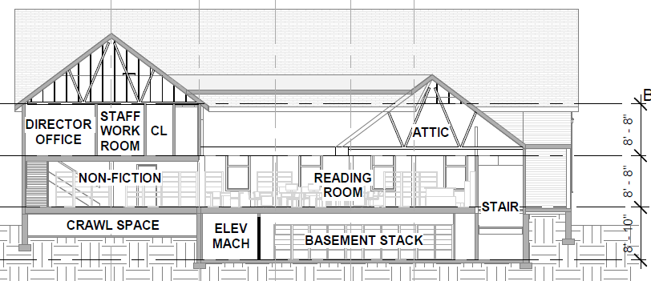
Option 2 – COURTYARD ADDITION
Lynnfield Library
FEASIBILITY STUDY

Slide 17
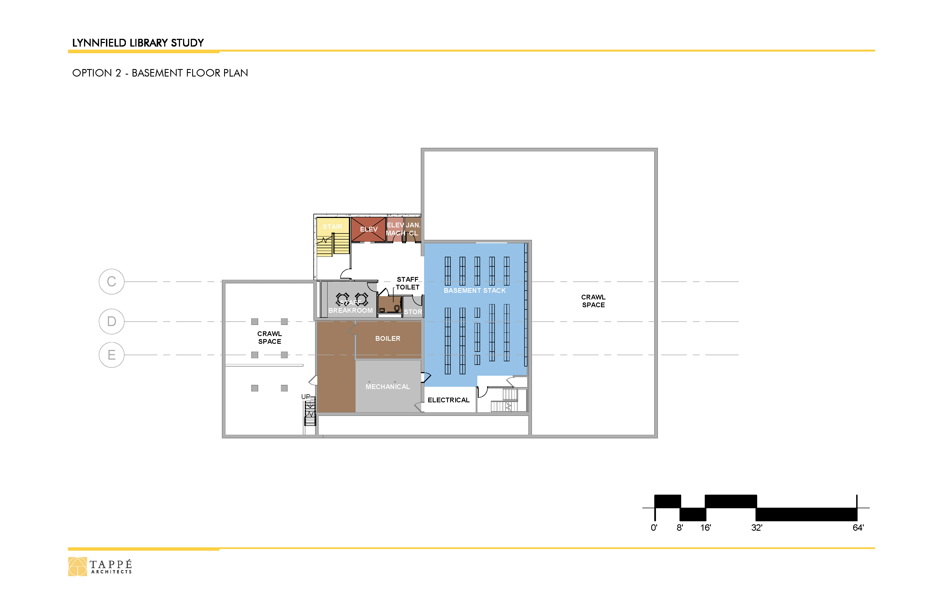
Option 2 – COURTYARD ADDITION
Lynnfield Library
FEASIBILITY STUDY
STORAGE

Slide 18
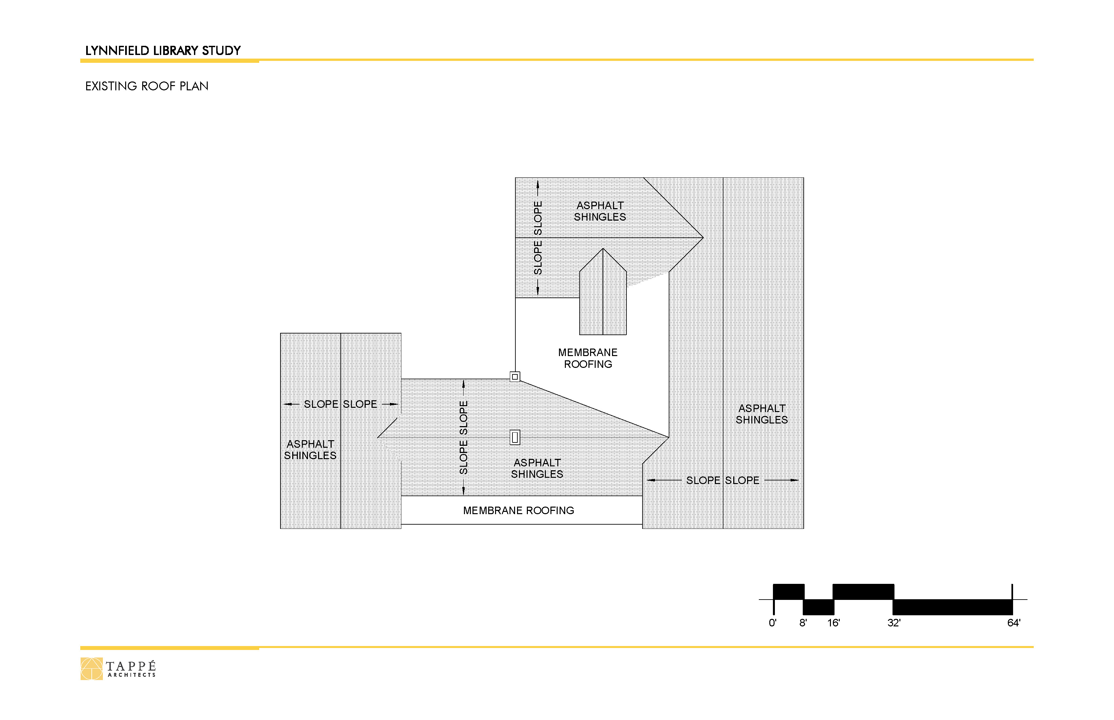
Option 2 – COURTYARD ADDITION
Lynnfield Library
FEASIBILITY STUDY

Slide 19
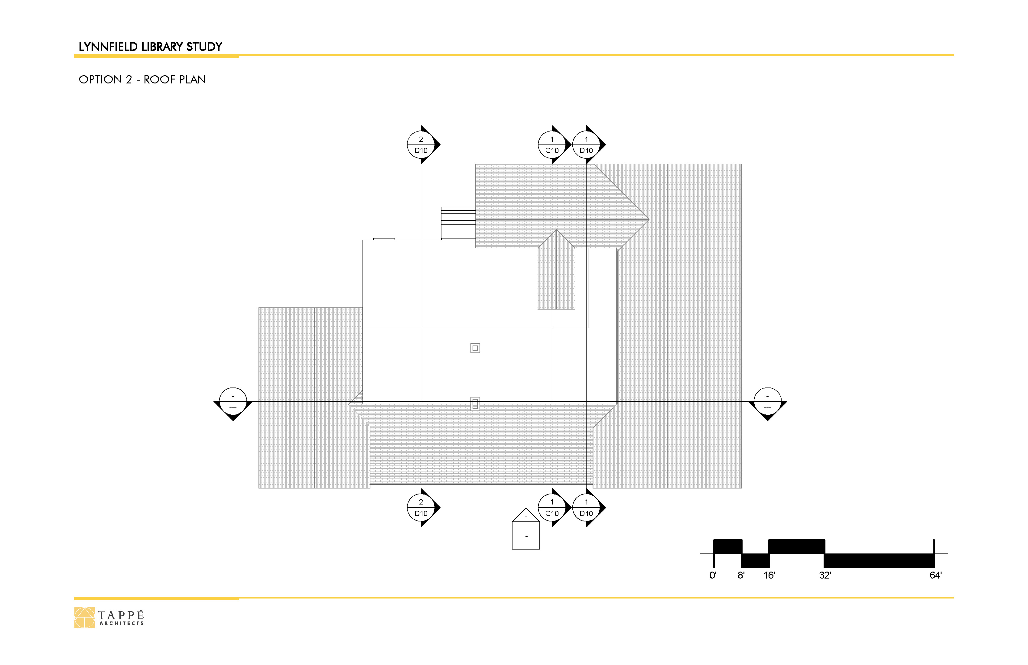
Option 2 – COURTYARD ADDITION
Lynnfield Library
FEASIBILITY STUDY

Slide 20
Option 2 –
COURTYARD ADDITION
Lynnfield Library
FEASIBILITY STUDY
Programmatic Impacts
Maintained Adult Collection Capacity
Increased Seating (approx. 45%)
Added Community Meeting Room (49 seats)
Added Group Study
Expanded Genealogy
Added/Improved Office Space
Consolidated Staff Workroom
Added Storage
More Flexible Children’s Space
Dedicated Teen Space with 2x Seating
Maintains Childrens Collection
Staff Breakroom Small, Basement Location
Friends Off-Site

Slide 21
Option 3 – COURTYARD ADDITION/VERTICAL EXPANSION
Lynnfield Library
FEASIBILITY STUDY
Goals
Option 2 Improvements, Plus:
Larger Community Meeting Room
Larger Children’s Space
Second Floor Main Floor Basement

Slide 22

Option 3 – COURTYARD ADDITION/VERTICAL EXPANSION
Lynnfield Library
FEASIBILITY STUDY

Slide 23
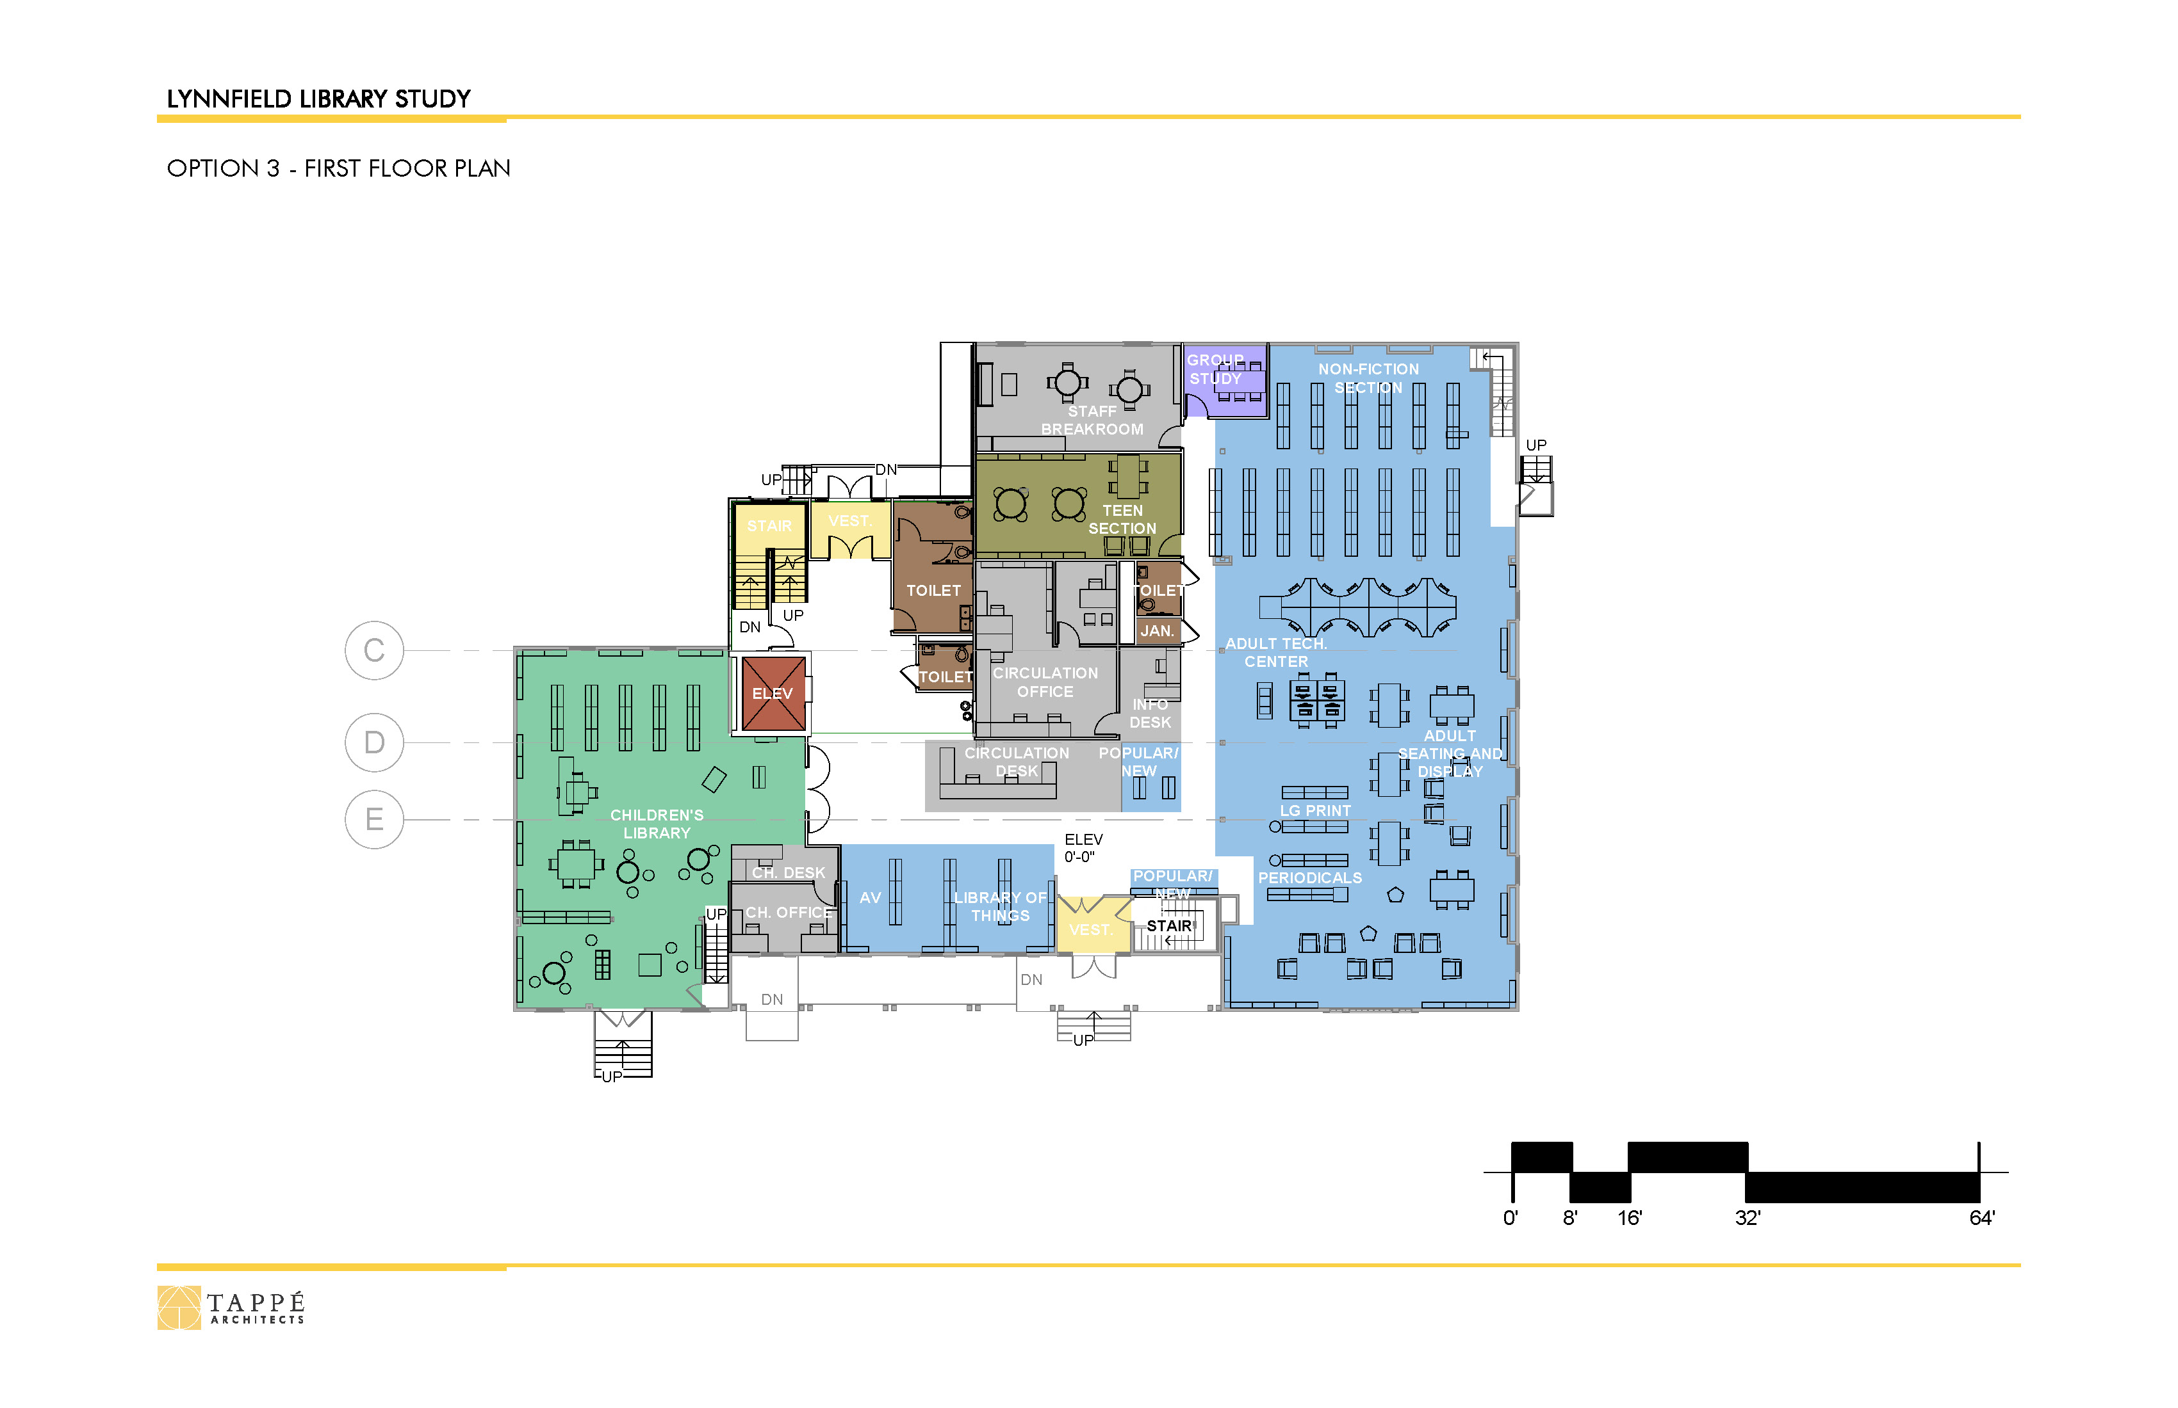
Option 3 – COURTYARD ADDITION/VERTICAL EXPANSION
Lynnfield Library
FEASIBILITY STUDY

Slide 24
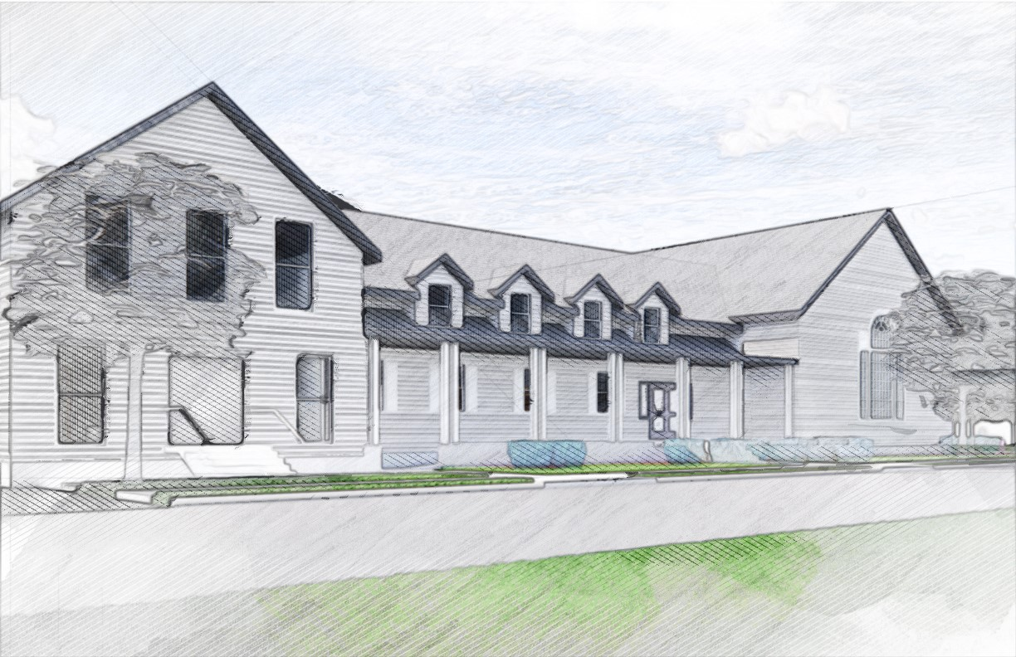
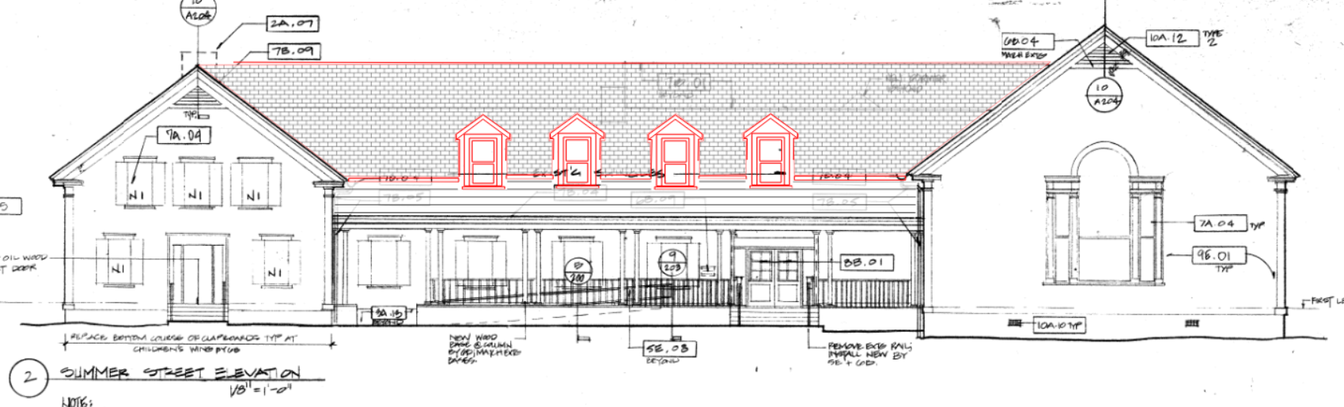
Option 3 – COURTYARD ADDITION/VERTICAL EXPANSION
Lynnfield Library
FEASIBILITY STUDY

Slide 25
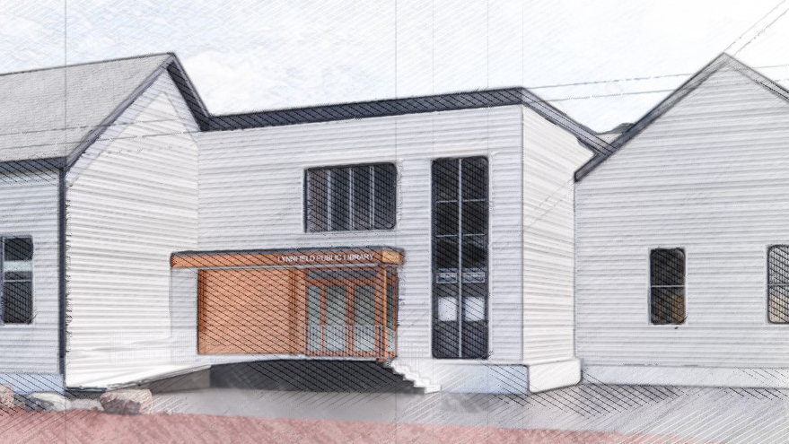

Option 3 – COURTYARD ADDITION/VERTICAL EXPANSION
Lynnfield Library
FEASIBILITY STUDY

Slide 26
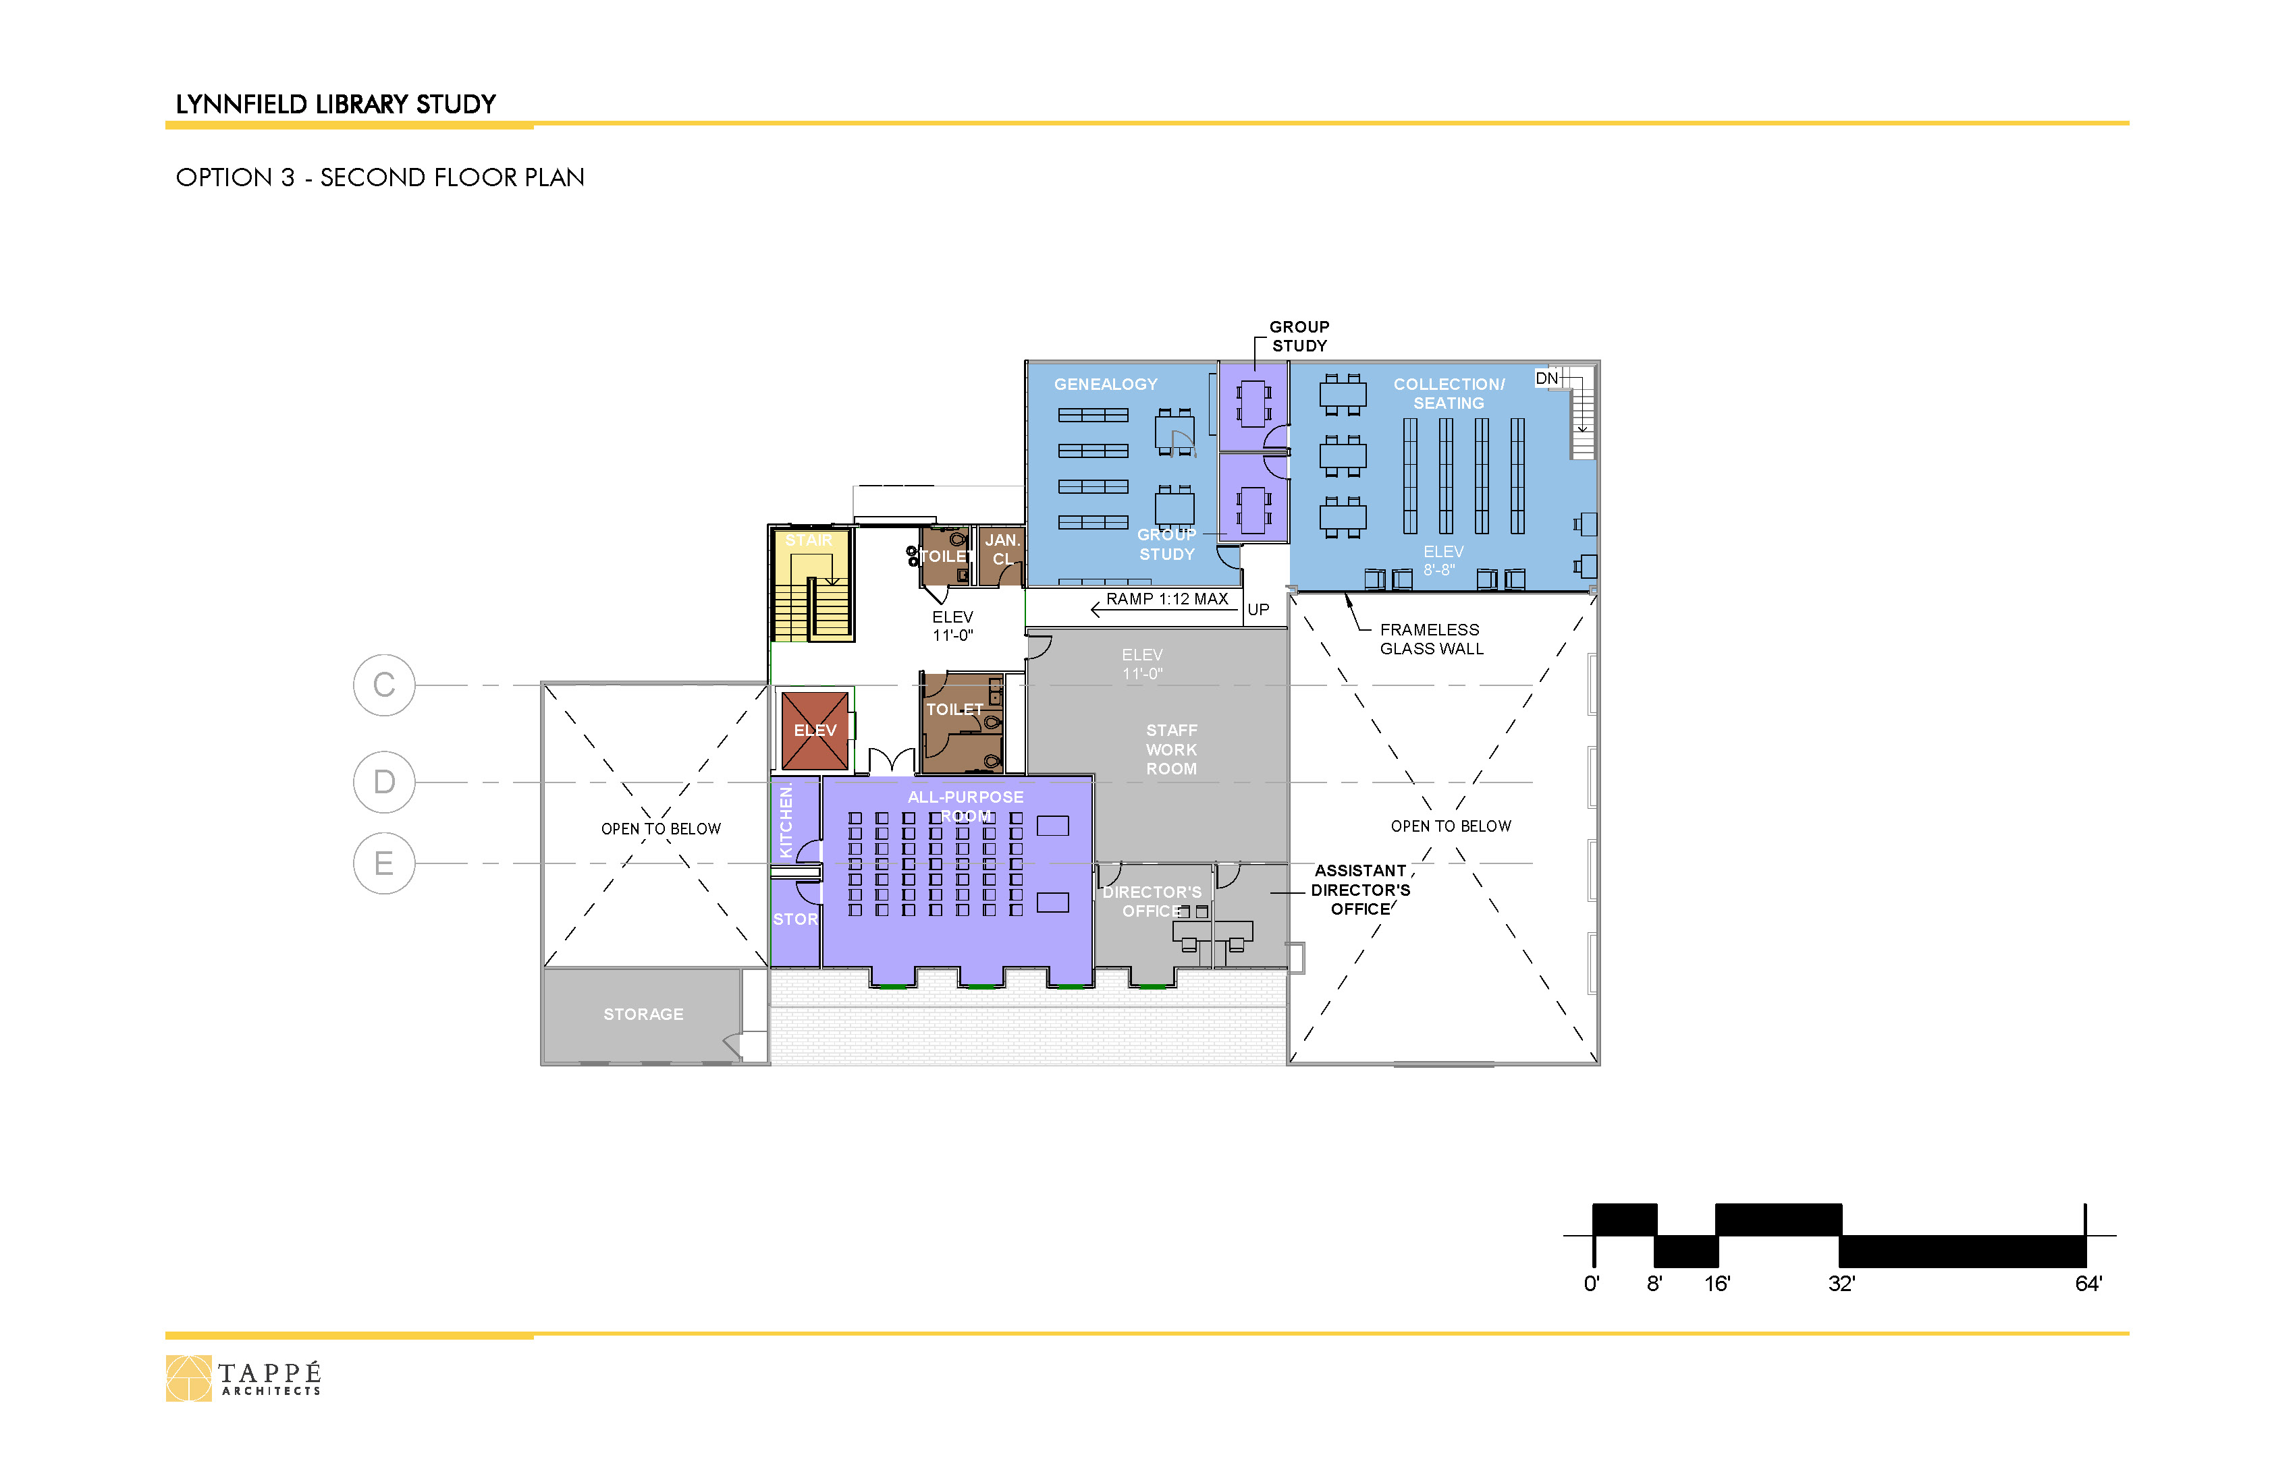
Option 3 – COURTYARD ADDITION/VERTICAL EXPANSION
Lynnfield Library
FEASIBILITY STUDY

Slide 27
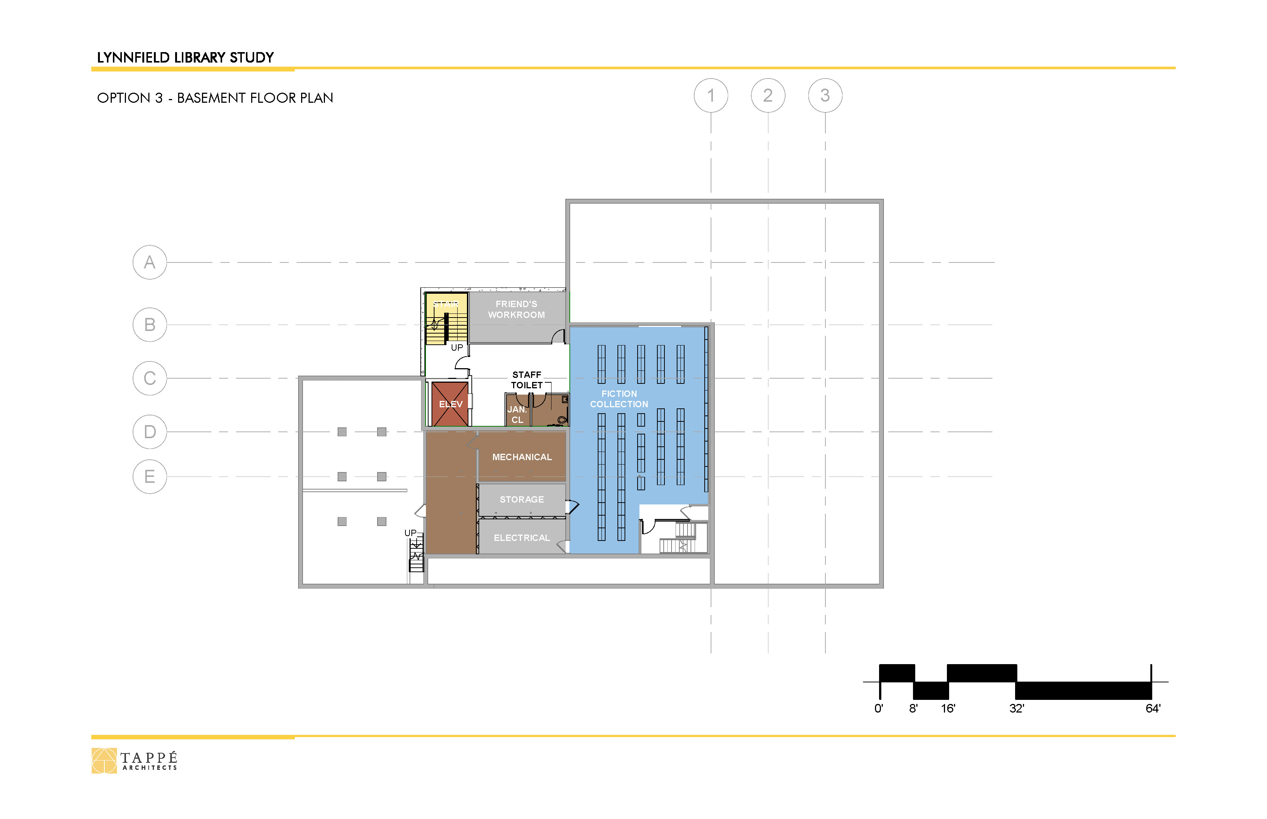
Option 3 – COURTYARD ADDITION/VERTICAL EXPANSION
Lynnfield Library
FEASIBILITY STUDY

Slide 28
Option 3 – COURTYARD ADDITION/VERTICAL EXPANSION
Lynnfield Library
FEASIBILITY STUDY

Slide 29
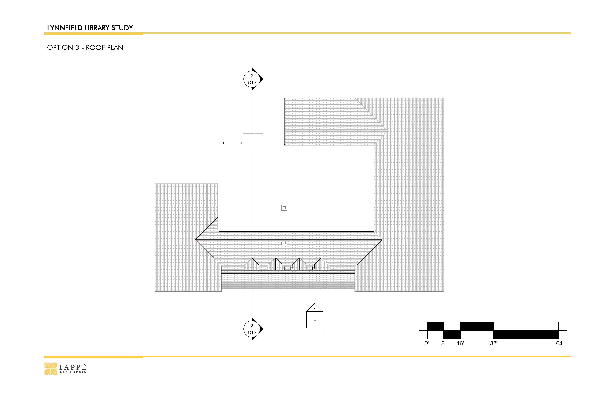
Option 3 – COURTYARD ADDITION/VERTICAL EXPANSION
Lynnfield Library
FEASIBILITY STUDY

Slide 30
COURTYARD ADDITION/
VERTICAL EXPANSION
Lynnfield Library
FEASIBILITY STUDY
Option 3 –
Programmatic Impacts
Expanded Adult Collection Capacity (approx. 14%)
Increased Seating (approx. 50%)
Community Meeting Room (49 seats), with Kitchenette
Added Group Study
Expanded Genealogy
Added/Improved Office Space
Expanded Staff Workrooms
Added Storage
Larger/More Flexible Children’s Space
Dedicated Teen Space with 2x Seating
Larger Staff Breakroom on Main Level
Friends On-Site
Expanded Childrens Collection (approx. 10%)

Slide 31
Comparison –
All Options
Lynnfield Library
FEASIBILITY STUDY

Slide 32
Next Steps
Lynnfield Library
FEASIBILITY STUDY
Early March Cost Projection
Mar. 6, 6:00 pm Presentation to Select Board

Slide 33
THANKS!
Lynnfield Library
FEASIBILITY STUDY

